Slide 1

skInsight Solution Type: Prototype
Ifeoluwa Oduwaiye
Notes:
Korrie

Slide 2



The Opportunity
The skincare industry is the third highest growing firm in Nigeria and has generated over $2 billion in revenue in just last year.
There is an acute shortage of dermatologists in the country and as such a lot of people rely on social media and peer influence when choosing skincare products.
Expert systems can be developed to detect these common skin defects and make recommendations on suitable local drugs they can use to treat the defects, thus leading to long-term economical growth.
Notes:
Korrie
updated 7/21

Slide 3
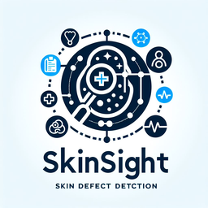
Solution
skInsight harnesses the power of AI and advanced software engineering to revolutionize how skincare companies and consumers approach skin health. By empowering local skincare brands, the platform offers a unique market edge and provides users with expert insights into their skin concerns.
skInsight’s Unique Selling Points
Personalized Expert Recommendations
Targeted Treatment Suggestions
Empowering Skincare Education
Affordable Dermatological Access
Notes:
Korrie
updated 7/21

Slide 4
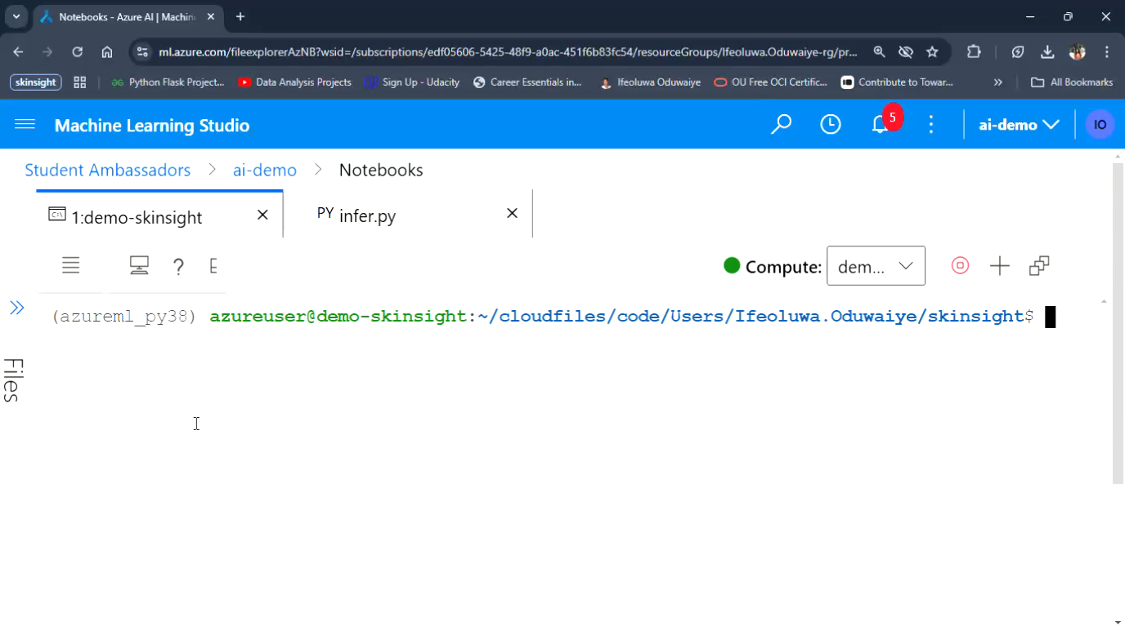
Demo
Notes:
Korrie
updated 7/21

Slide 5
Takeaways
To conclude, adopting skInsight into the dermatology industry would not only help speed up diagnosis, but it would also help the local economy by prioritizing quality local product recommendations over international product recommendations.
Additionally, integrating skInsight into organizational workflows, can help skin healthcare providers offer quicker and more precise diagnoses, reducing the burden on patients and improving outcomes.
Notes:
Korrie
updated 7/21

